Slide 1

Exception Handling Fundamentals
&
Techniques
Notes:
Hello everyone, welcome to our session on "Exception handling Fundamentals and Advanced Techniques”, In this presentation we will cover Introduction and Implementation of Exceptions, Fundamentals- Terminology and Types, Handling Exceptions, Advanced Techniques- Nested Blocks and Chained Exceptions,Advanced Techniques- Multithreading, Realworld Examples and Pitfalls and Best practices and Guidelines.

Slide 2

Introduction & Importance
What are exceptions?
Anomalous conditions that disrupt program flow.
Can be caused by various factors (e.g., user input, resource errors, network issues).
Importance of exception handling
Ensures program stability and prevents crashes.
Allows for graceful handling of errors.
Improves application robustness and user experience.
Benefits of proper exception handling
Increased code quality and maintainability.
Easier debugging and troubleshooting.
Improved error reporting and logging.
Provides a more predictable and reliable program execution.
Notes:
What are exceptions?: We'll begin by defining exceptions and their significance in software development.
Importance of exception handling: Discussing why proper exception handling is essential for robust and reliable software.
Benefits of proper exception handling: Exploring the advantages of implementing effective exception handling practices.

Slide 3
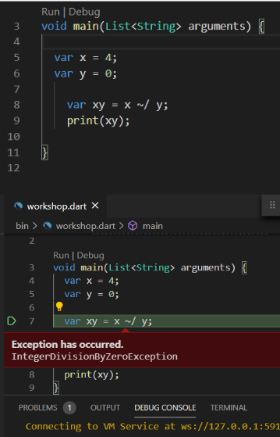
Exception
Here, We Programmed a execution to divide a variable x with y, but the user given is “ x as 4 and y as 0 ”
In ordinary arithmetic, the expression has no meaning, as there is no number which, when multiplied by 0, gives a (assuming a ≠ 0), and so division by zero is undefined.
So it will be a problem during execution.which automatically terminate the program.
So for those problems that rise during executions are called exception
And solving that is exception handling

Slide 4
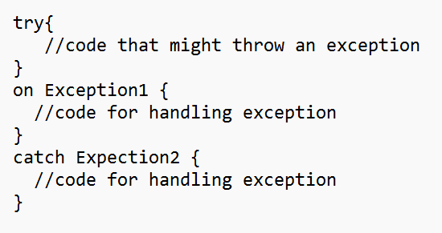
Handling Exceptions
try, try block will carry the statement that has the chance to get an exception.
on, on block is set to know the specific exception and apply certain statements.
catch, catch block is set when the program doesn't know what exception occured (because no on block initiated), but the program must not break.
finally, finally block is the only block which will execute weather the exception is there or not.

Slide 5
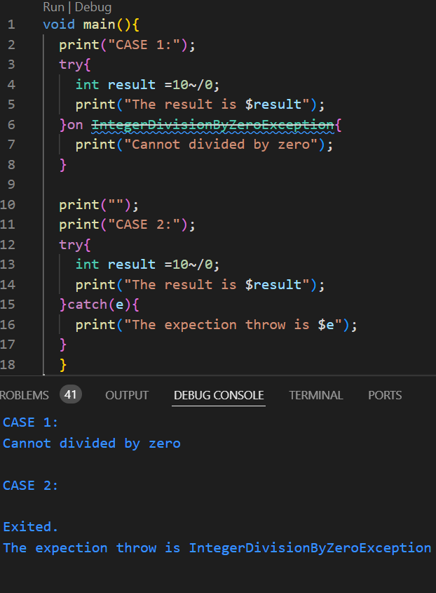
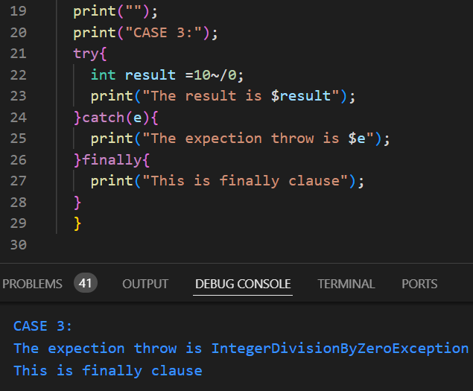
Examples:
In this code :
Case1 : When you know the exception is thrown , use ON
Case2: When you don’t know the exception use catch
Finally
case3:

Slide 6
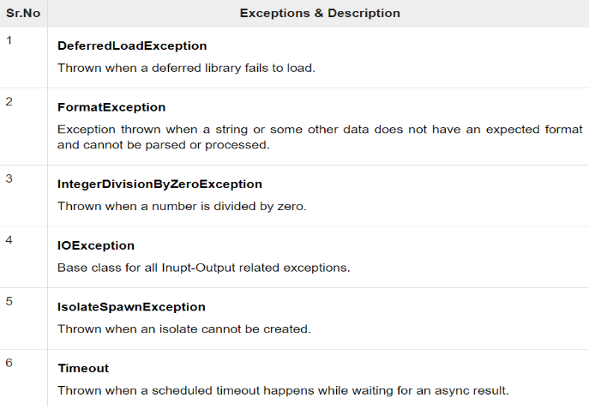
Notes:
Exception handling in multithreaded environments: Addressing the challenges and considerations for handling exceptions in concurrent and multithreaded applications.
Thread safety considerations: Discussing the importance of ensuring thread safety and synchronization in exception handling mechanisms.

Slide 7
Custom Exception
Custom exceptions are exceptions we create.
For example, Think if a problem rises when the device is getting hot, but managing that problem is not an exception because that type of exception is not there, but it’s a problem.So for that we will create an exception for the problems that are not listed in the types of exceptions.
But for creating an custom exception we must know about some keywords
class
constructor
implements
throw
Notes:
Principles for robust exception handling: Outlining best practices and principles for designing resilient and maintainable exception handling mechanisms.
Designing for maintainability and readability: Emphasizing the importance of clear, concise, and maintainable exception handling code.
Choosing the right approach: Providing guidelines for selecting the appropriate exception handling approach based on the specific requirements of the application.

Slide 8
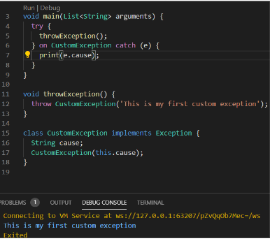
class- class is where we group items related to a base item, in other words its an library.
constructor- constructor is responsible for allocating memory for new objects inside a class.
Implements- An implementation class defines the physical implementation of objects of a class.
throw- throw keyword is used to explicitly raise an exception. A raised exception should be handled to prevent the program from exiting abruptly.
(detailing of these keywords will be found in following modules)

